Slide 1

How Do You Equip Communications Teams to
Build Public Trust?

Slide 2

How Do You Equip Communications Teams to
Build Public Trust?
The issues we were facing at Surrey County Council:
Lack of clarity on residents' views
Small local issues escalating
A few voices distorting our focus
Inconsistent engagement
Policy development not being based on the right insight

Slide 3







Resident Intelligence Unit
Creating a central function for insight and intelligence
Behaviour Change
Research
Consultations and Engagement
Unified approach framework
Knowledge sharing
Holistic view of engagement
Advice and support
Insight reports pulling on polling, socials and media analysis
Resident sentiment and satisfaction tracking
Insight-led decision making
Allow evaluation of outcomes, gaps and opportunities
A more coherent resident experience

Slide 4
How Do You Equip Communications Teams to
Build Public Trust?
We will cover:
What is trust?
Is there a trust crisis?
Why is trust so important and what drives trust?
COM-B and building relationships
Five takeaways of equipping your team to build public trust.

Slide 5

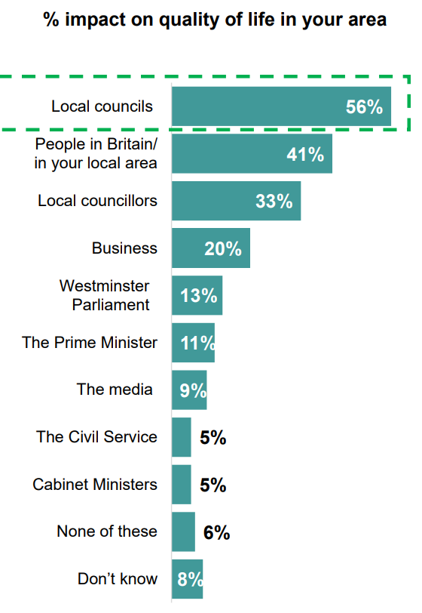
A trusts B to deliver X (without oversight)*
Residents trust us (local government) to deliver services for their local area.
However, the focus should never be about trust in individuals but instead building organisational trustworthiness.
What is trust?
Source: Ipsos polling for the LGIU in 2023
*Source: LGIU, Bunting and Stride

Slide 6
What is research telling us about levels of public trust?
57 %
No or little trust in government
46 %
No or little trust in local government
Source: ONS 2023

Slide 7
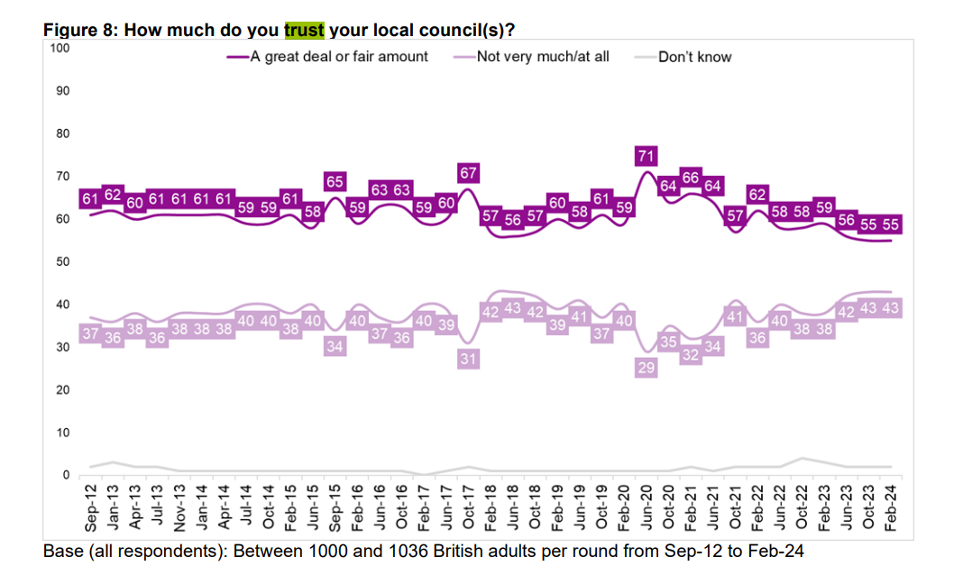
But, are we in a trust crisis?
Source: LGA Resident Satisfaction Survey, Round 37, February 2024

Slide 8
How do you measure trust?
IPSOS The Foundations of Trust
Basic Trust
reliable and keeps it promises
good at what it does.
Active Trust:
Behaves responsibly
open and transparent
is well led
Interactive Trust
It does what it does with the best of intentions
It shares my values
It would try to take advantage of me if it could
Deloitte measure:
Competence
Intent
OECD measure:
Integrity
Openness
Fairness
Reliability
Responsiveness

Slide 9

So why has trustworthiness become more important than ever?
High levels of political polarisation, with Social and cultural divisions becoming more entrenched*
Increased levels of time poor audiences and media outlets producing provocative content to grab attention*
Risks of public mis and disinformation*
Challenging funding environment

Slide 10
Applying a behavioural lens to comms planning
Three step process
1. Understand why people behave the way they do
2. Determine their barriers to behaviour change
3. Identify potential solutions and interventions
COM-B and Relationship Building

Slide 11
Understand why people behave the way they do
National sources (Office of National Statistics , Consumer Data Research Centre , OFCOM , Ipsos , National Institute of Economic and Social research , LGA, NHS England)
Local data (population, service data, JSNAs, past consultations, past surveys)
Segmentation tools (ACORN , MOSAIC)
Primary research (commissioned/ free surveys and focus groups)

Slide 12
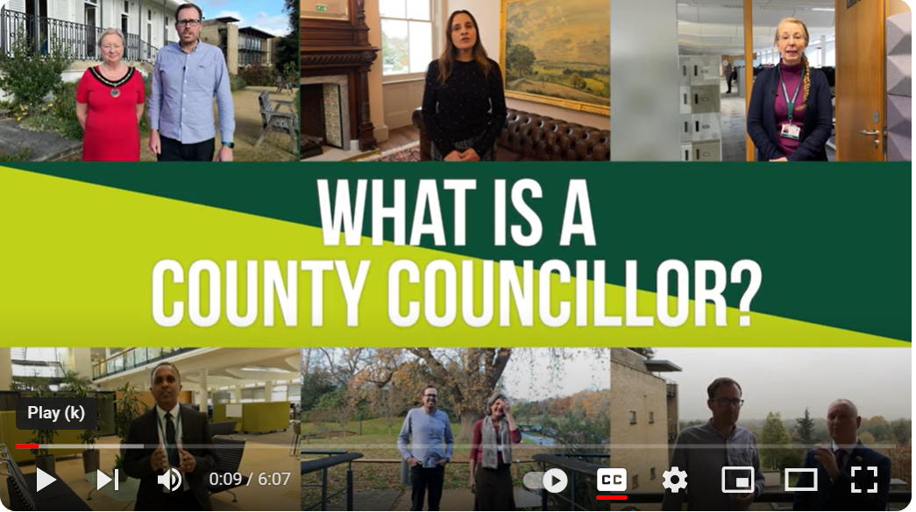
Capability
Barriers to engagement
Lack of understanding on council services/ support
Lack of knowledge on council’s role vs a borough council
Confusing systems/ language
Interventions
Informative/ awareness campaigns on competence / intent
raise awareness of council’s role / Cabinet Member
Use insight and resident voice to improve customer journeys

Slide 13

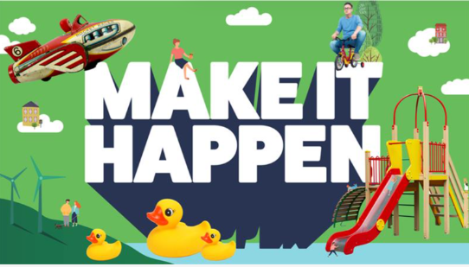

Motivation
Barriers
No emotional reward or incentivisation
Lack of interest/ trust
Not listened to, no feedback
Interventions
Communicate rewards and celebrate local success
Information on how councils make decisions – increase transparency
Share regular updates – show you are listening
Use trusted voices

Slide 14
Opportunity
Opportunity needs system wide changes to overcome barriers
Barriers
We are not where our residents are having conversations about our services
No time
Non-responsive channels
No social norms to engage
Interventions
Comms can make social media channels more responsive
Comms can increase presence across earned channels
Work across system – unify your engagement and communicate as one council

Slide 15
Recap: How to Equip your team to build public trust
1. Start to measure trust – benchmark against national averages
2. Communicate on the drivers of trust thinking about perception, confidence and managing expectations
3. Focus on local issues that matter to residents the most (not what your organisation wants to talk about)
4. Champion your audience voices, use your insight to push for service change and feedback to your audience
5. Be resident centric, not service centric and prioritise a unified approach to resident engagement

Slide 16
Further reading and resources
Trust
Residents' satisfaction surveys | Local Government Association
ONS Trust in Government
LIGU collection@40: Trust
Deloitte Enterprise Trust: Put Trust behind everything you do
Ipsos Global Trustworthiness Monitor
OECD: Public Communication Scan of the UK
Insights
ONS Census data
Acorn tableau tool
Acorn audience segmentation
Mosaic audience segmentation
Citizens Advice Running Community Focus Groups
Behaviour change
GCS behaviour change – COM-B
NSW Behavioural Insights Unit – sludge toolkit

Slide 17
Thank you
Please get in touch with any questions
Andrea.newman@surreycc.gov.uk
Katherine.Shipton@surreycc.gov.uk
Judith.holden@surreycc.gov.uk

